Slide 1
Budget Analytics
Prajakta Bose

Slide 2
Introduction
Problem Statement:
The project likely aims to analyze sales, customer, product, and territory data to uncover insights into sales performance, customer demographics, product popularity, and geographical sales distribution. The analysis seeks to identify patterns, trends, and opportunities for growth and improvement in sales strategies.
Project Overview:
This project involves consolidating and analyzing data from various sources related to AdventureWorks dataset. The data includes details on customers, products, sales, and territories. The analysis encompasses data cleaning, merging datasets, exploring data to understand the distribution and relationships between various variables, and conducting cohort analysis to assess customer retention.

Slide 3
Objectives
Objectives:
Data Integration: To merge data from multiple sources (customers, products, sales, territories) into a cohesive dataset for analysis.
Data Cleaning and Preprocessing: To clean the data by handling missing values, removing duplicates, and adding relevant columns for analysis (e.g., sales year, month).
Exploratory Data Analysis (EDA): To explore data through various visualizations and statistical summaries to understand the sales distribution across products, categories, and regions; customer demographics; and order patterns.
Sales Performance Analysis: To evaluate sales performance over time, identifying top-selling products and assessing sales by category and subcategory.
Customer Segmentation: To segment customers based on their purchase behavior using RFM (Recency, Frequency, Monetary) analysis.
Cohort Analysis: To perform cohort analysis to assess customer retention over time.

Slide 4
Methodology
Data Preprocessing:
Data Loading: The project involves loading budget or financial data from Excel files.
Initial Data Inspection: This involves using methods like .head(), .info(), or .describe() to get a quick overview of the dataset.
Cleaning and Transformation: Data cleaning could involve handling missing values, removing duplicates, or correcting data types. Transformation steps might include normalizing data, extracting features, or converting categorical data into a format suitable for analysis.
Exploratory Data Analysis (EDA):
Statistical Summaries: Utilizing descriptive statistics to summarize the central tendency, dispersion, and shape of the dataset's distributions.
Visualizations: Creating plots and charts to visually explore the data.

Slide 5
Data Analysis
Key Findings & Insights:
Spending Patterns: Identification of major areas of spending within the budget, highlighting where the bulk of resources are allocated.
Trend Analysis: Insights into how spending has evolved over time, indicating areas of increasing or decreasing investment.
Cost Drivers: Analysis of the main drivers of costs within the organization, potentially identifying efficiency improvement opportunities.
Budget Allocation Efficiency: Assessment of how well the budget is allocated across different departments or projects, with insights into potential over or underfunding.

Slide 6
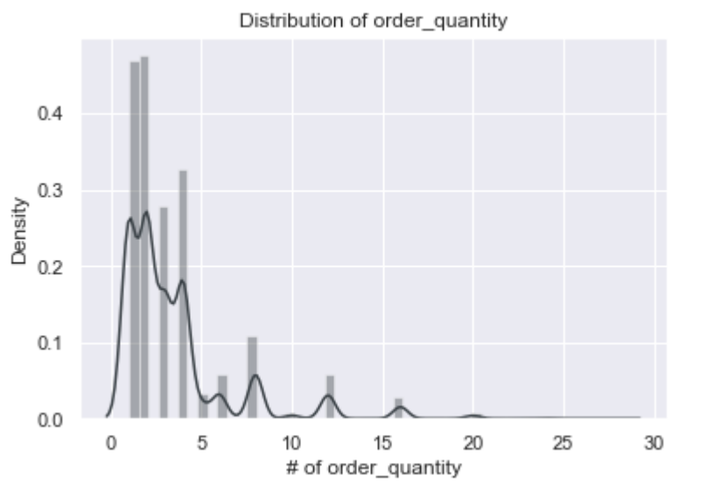
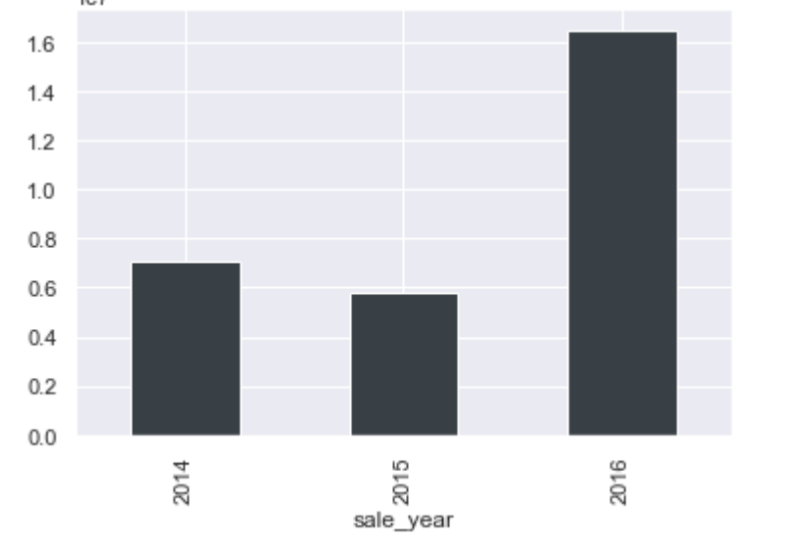
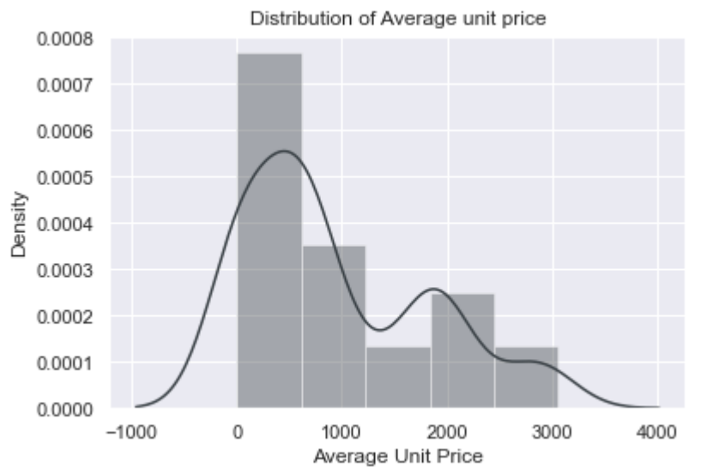
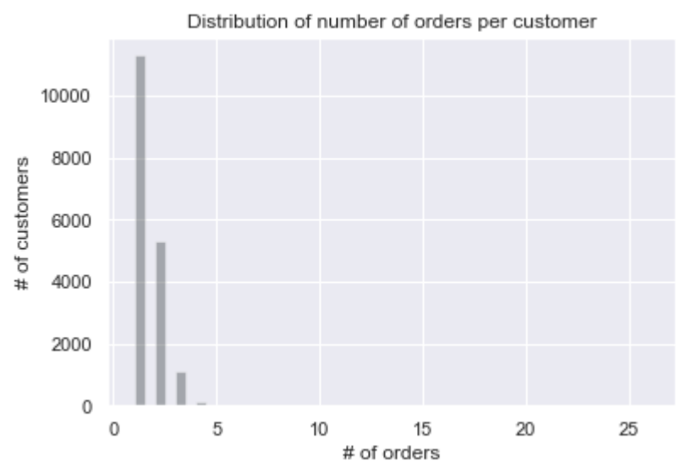
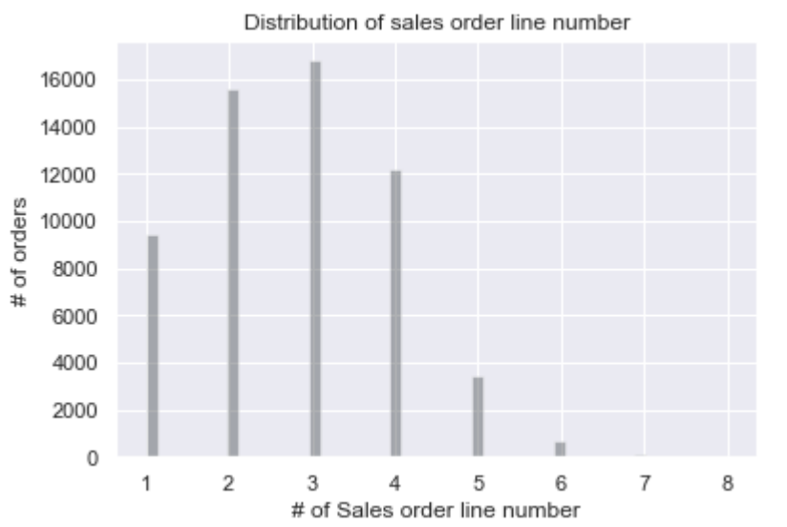
Key Visualizations

Slide 7
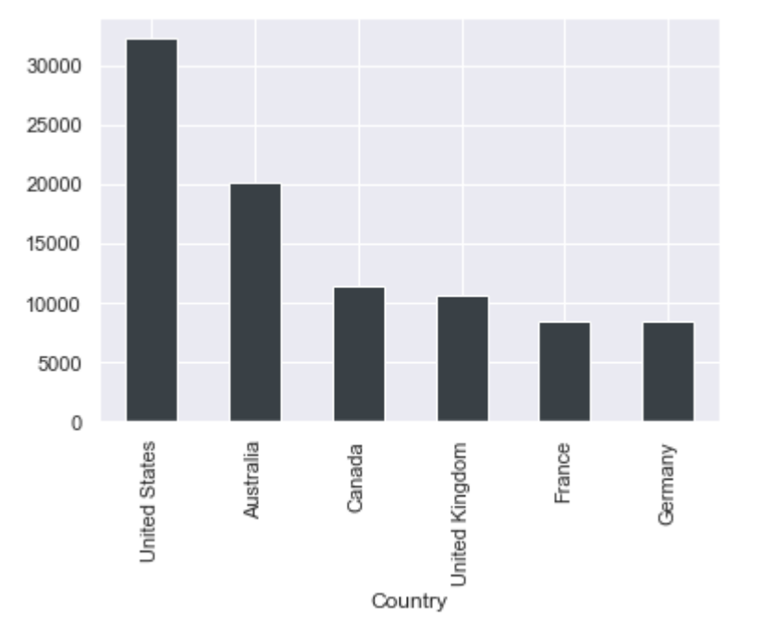
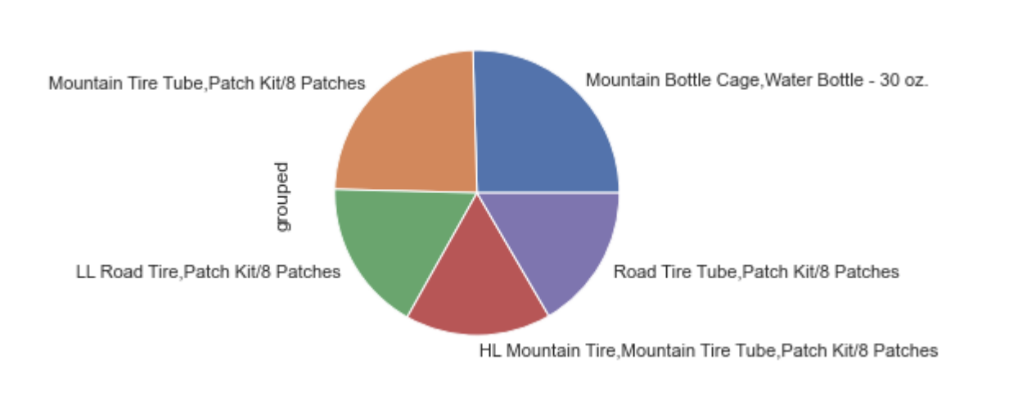
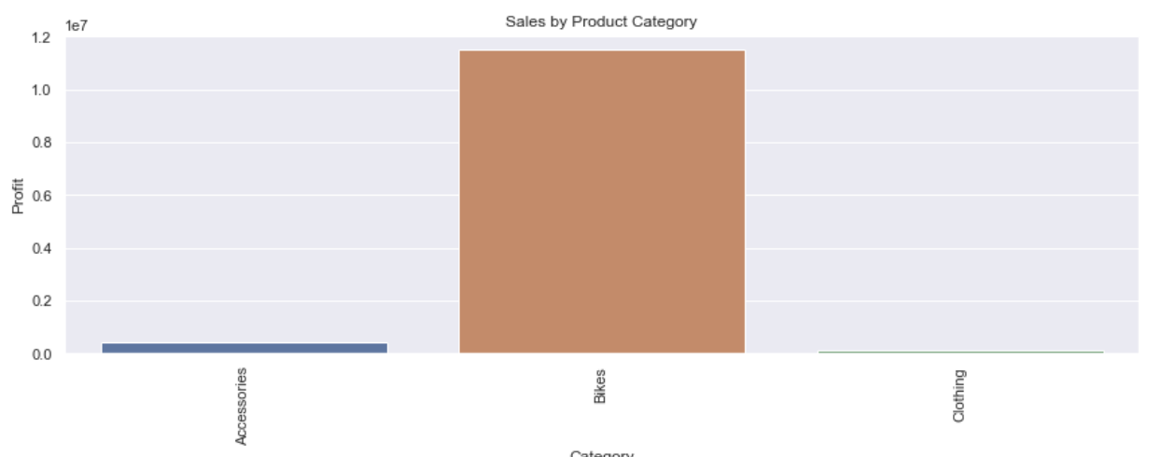
Key Visualizations

Slide 8
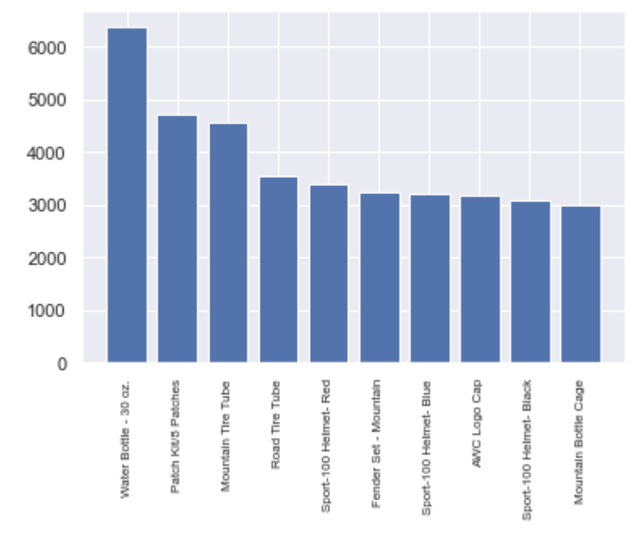
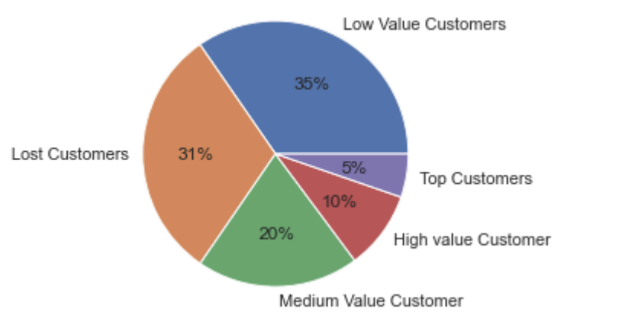
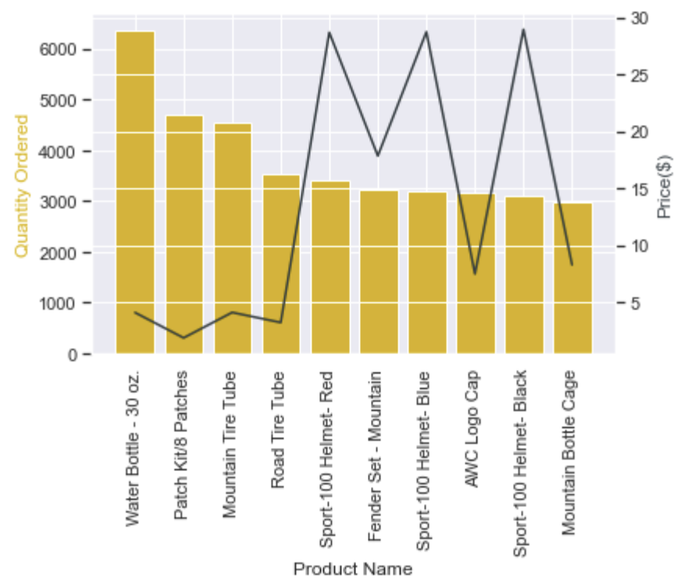
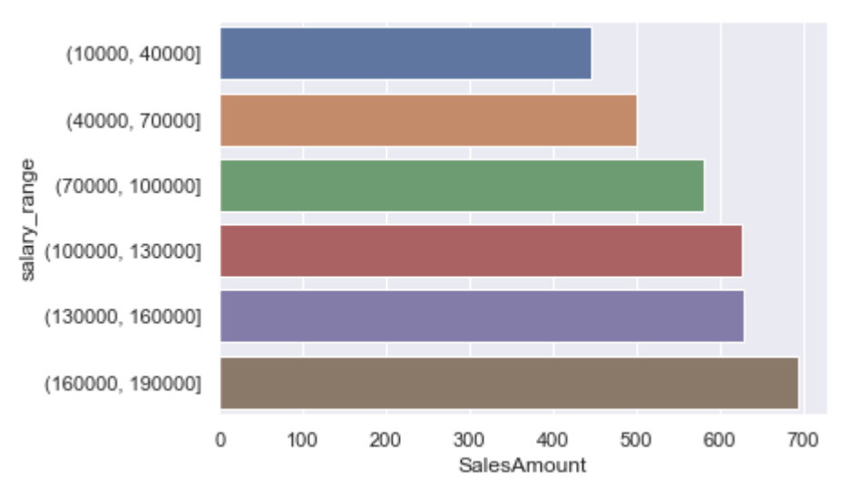
Key Visualizations

Slide 9
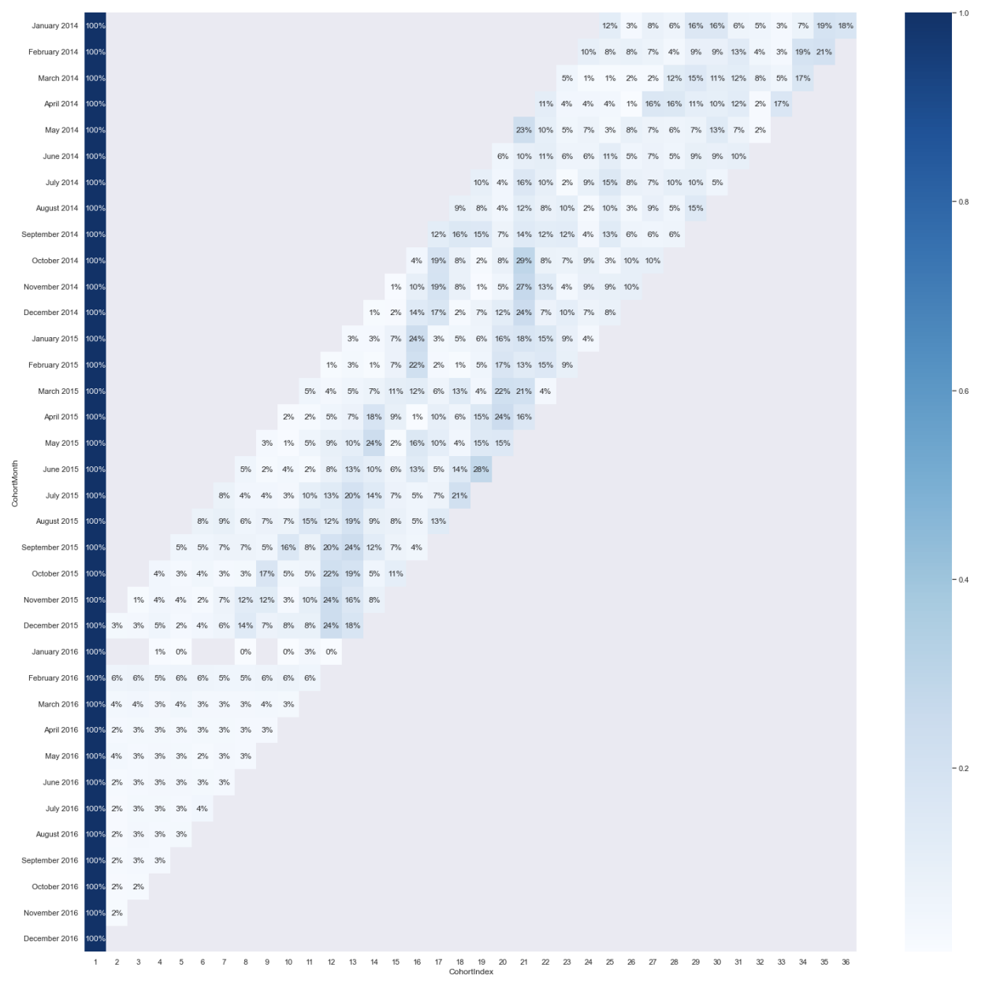
Key Visualizations

Slide 10
Conclusion
Summary of Findings:
The project successfully concludes with insights into how effectively the budget is managed, areas where cost savings could be realized, and recommendations for optimizing future budget allocations.
Future Directions:
Further Data Collection: To enhance the analysis with more comprehensive data over a longer time frame or from additional departments.
Predictive Modelling: Using the insights gained to forecast future spending trends or to model the impact of budget changes.
Automation of Analysis: Developing tools to automate the regular review of budget data, allowing for real-time insights and adjustments.

